Slide 1
MBSE Driven IoT For Smart Cities
Matthew Whitesides
CS6102: Model Based Systems Engineering

Slide 2
Overview
Definitions
Technical Paper Discussion
MBSE Approach
Challenges
Conclusions

Slide 3
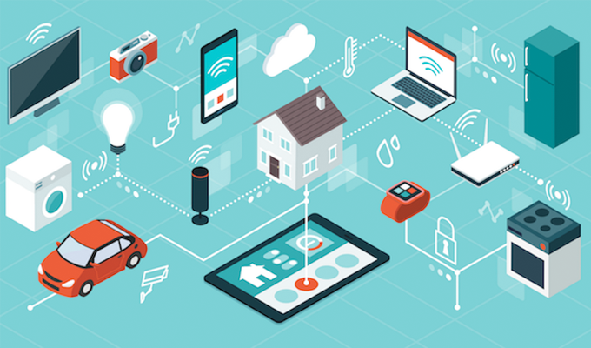
What is IoT?
“The Internet of things (IoT) is a system of interrelated computing devices, mechanical and digital machines, objects, animals or people that are provided with unique identifiers (UIDs) and the ability to transfer data over a network without requiring human-to-human or human-to-computer interaction.”
Essentially IoT is a perfect candidate for MBSE as it inherently is a system of individual systems.

Slide 4
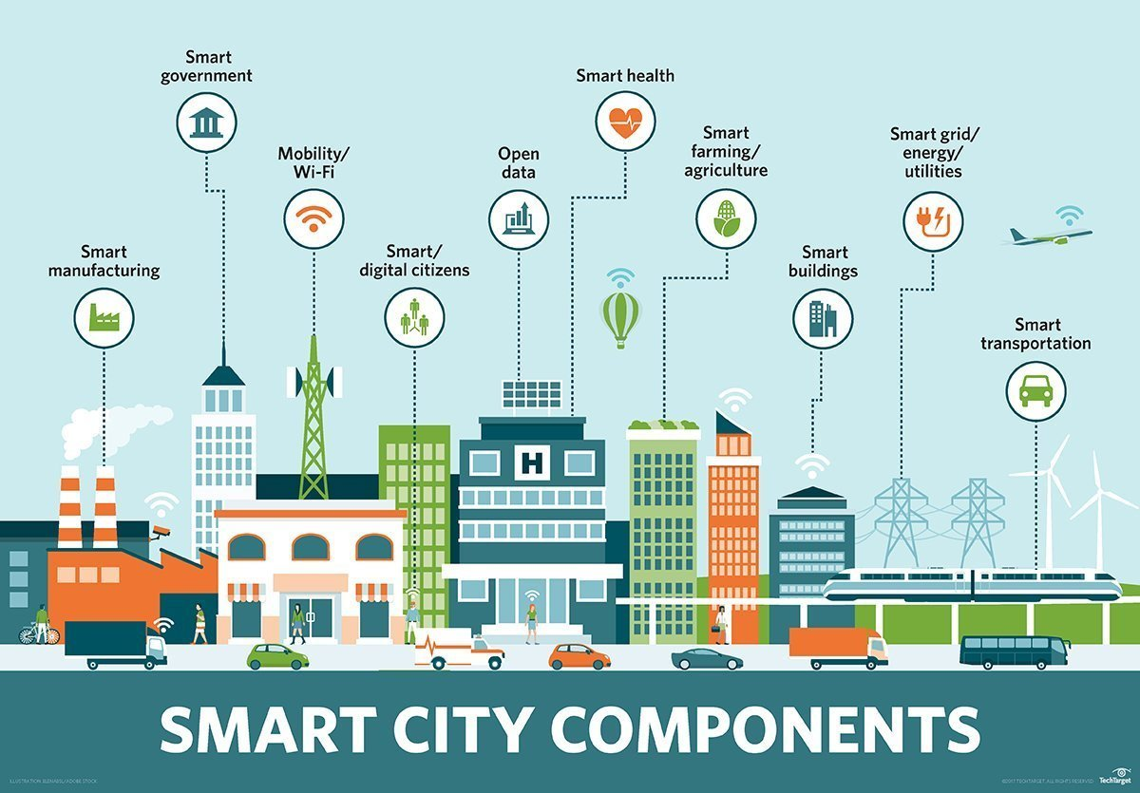
What is a “Smart City”?
“A smart city uses digital technologies or information and communication technologies (ICT) to enhance quality and performance of urban services, to reduce costs and resource consumption, and to engage more effectively and actively with its citizens.”

Slide 5
Paper Discussion
Making Smart Cities Smarter – MBSE Driven IoT
By Matthew Hause and James Hummell
Discusses the challenges in creating a smart city and how a MBSE approach can be used.

Slide 6
Challenges
Systems deploying the IoT require a different infrastructure, this includes modified hardware, software applications, and an operating system embedded in the product itself.
Concerns include:
Security
Infrastructure & Architecture
Monitoring

Slide 7
MBSE Approach
Can be broken down into “capability”, “operational” and “systems” views of modeling.
Operational views would be how systems implements their capabilities.
System views are more detailed in that they define how the individual system hardware and software interfaces with itself and each other.

Slide 8
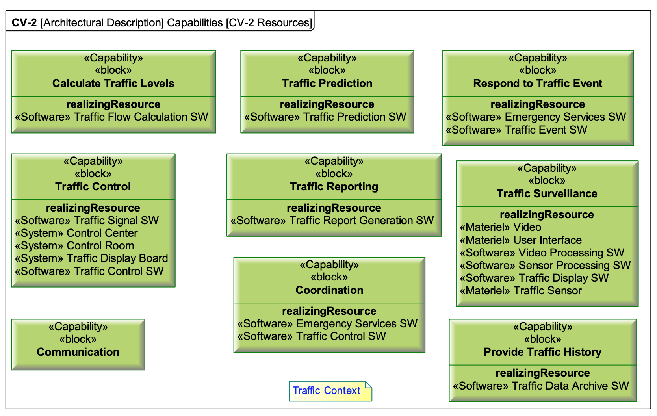
MBSE Approach: Operational View

Slide 9
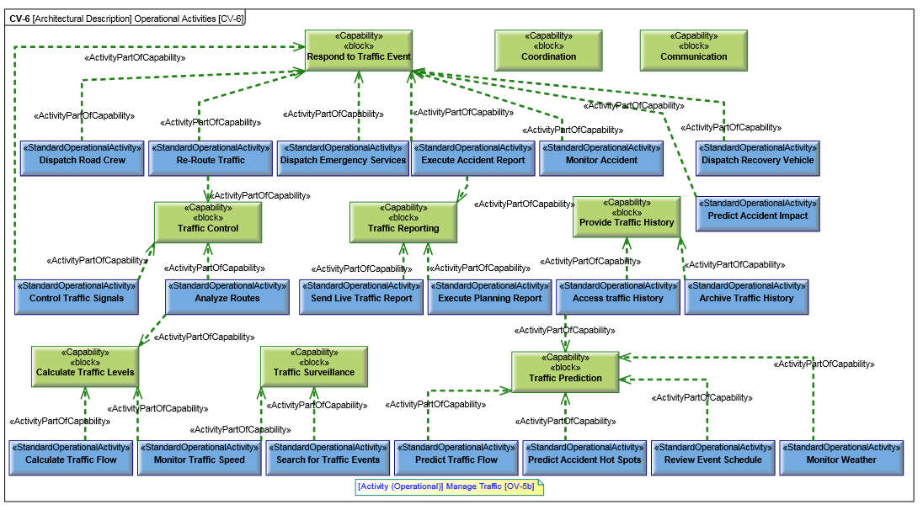
MBSE Approach: Operational View

Slide 10
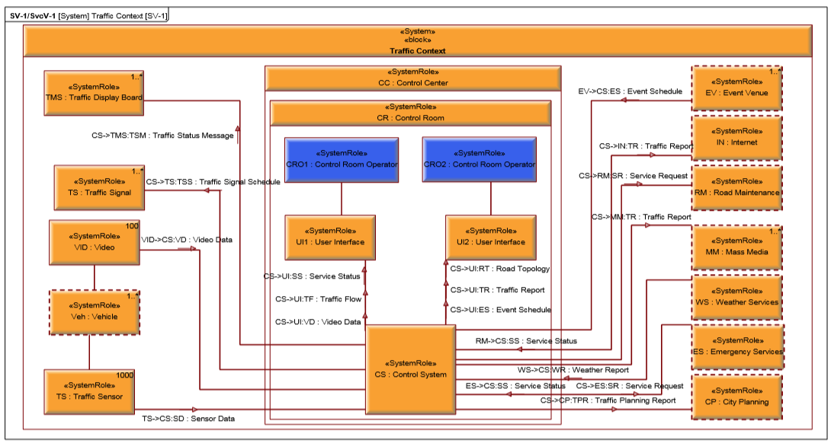
MBSE Approach: Systems View

Slide 11
Conclusion
Questions?
References:
Matthew Hause and James Hummell.Making Smart Cities Smarter – MBSE Driven IoT. 26th Annual IN-COSE International Symposium (IS 2016) Edinburgh, Scotland, UK, 18 July 2016.

